Slide 1
The downpour…
Notes:
These are the new categories – will these titles be visible in anyway to the players? It would help in their understanding of the game. What about if the category appears at the top of the corresponding ‘Chance Card’?

Slide 2
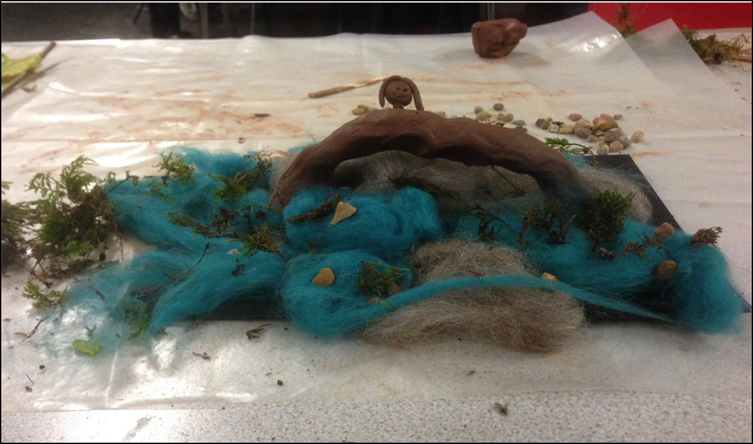
And then about 8 o’clock I saw the water…
Notes:
We would prefer it if all of the direct quotes were in italics.

Slide 3
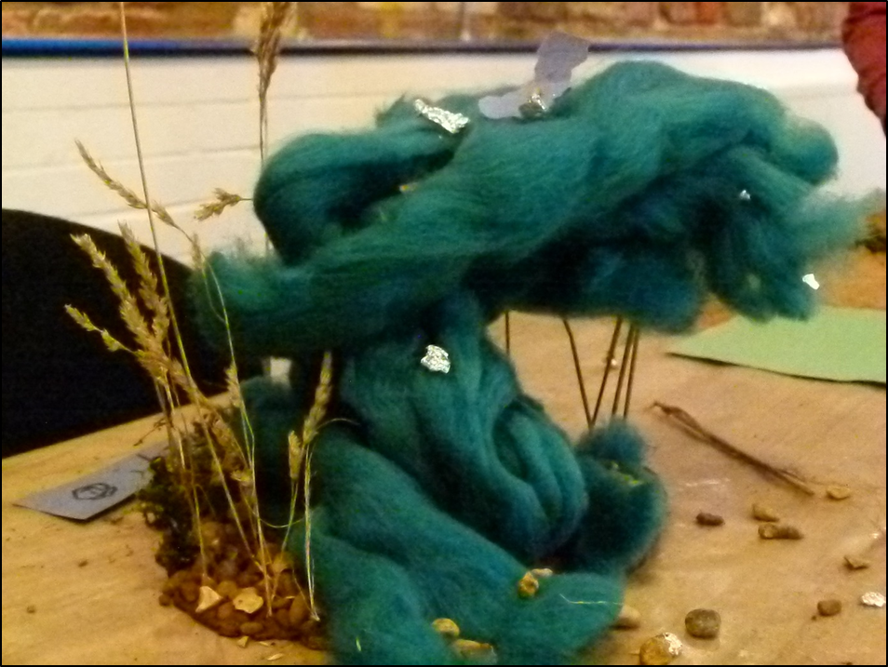
That’s where I first saw the water coming through the hedge…and my heart started going really fast.
Thomas, aged 9

Slide 4
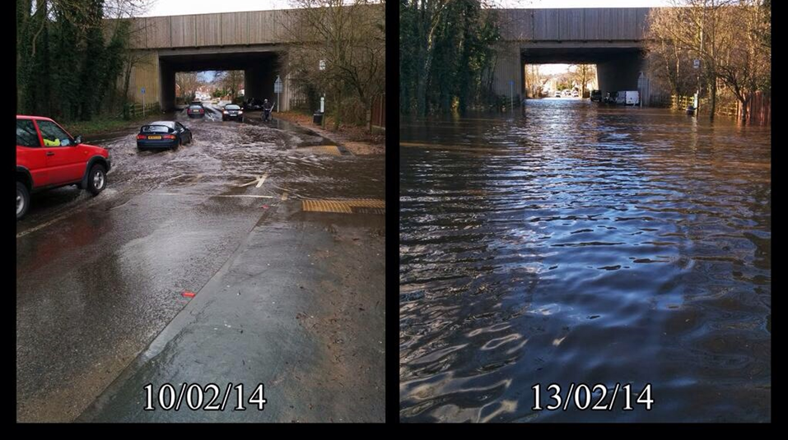
There had been a puddle for about a week, and then all of a sudden it just kept rising and rising…
Peter, aged 14

Slide 5
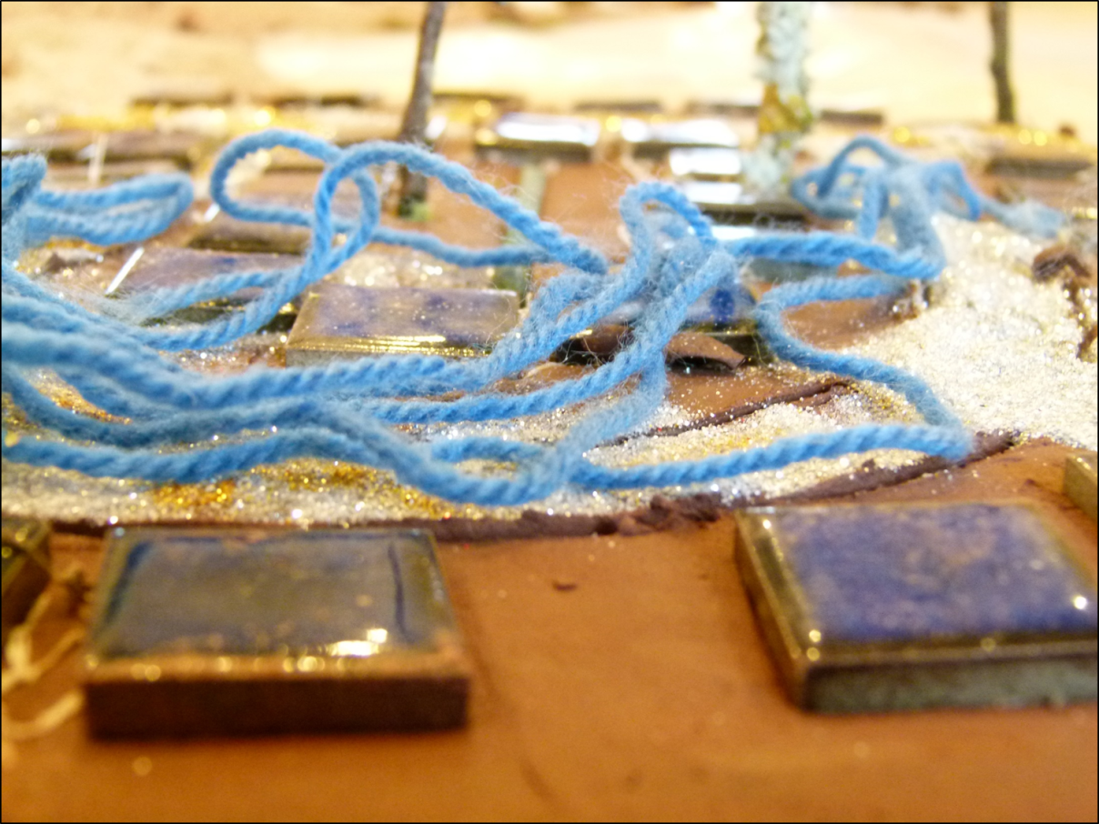
At first me and my brother thought it was quite fun but then it kept on going up higher and higher and it started scaring us because we didn’t know what would happen next.
Ben, aged 12

Slide 6
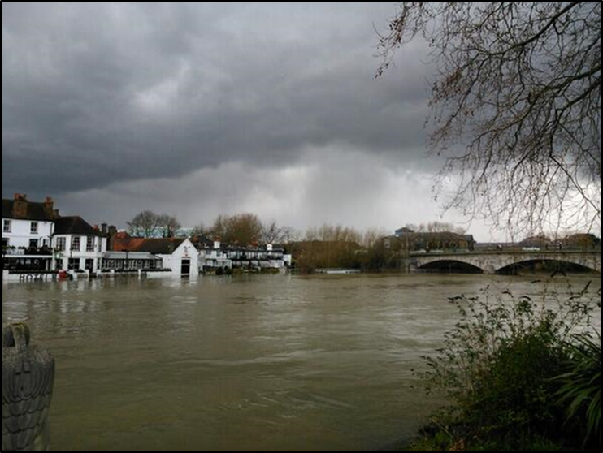
The water rose about eight inches in two hours or something…it went up really fast.
Ben, aged 12

Slide 7
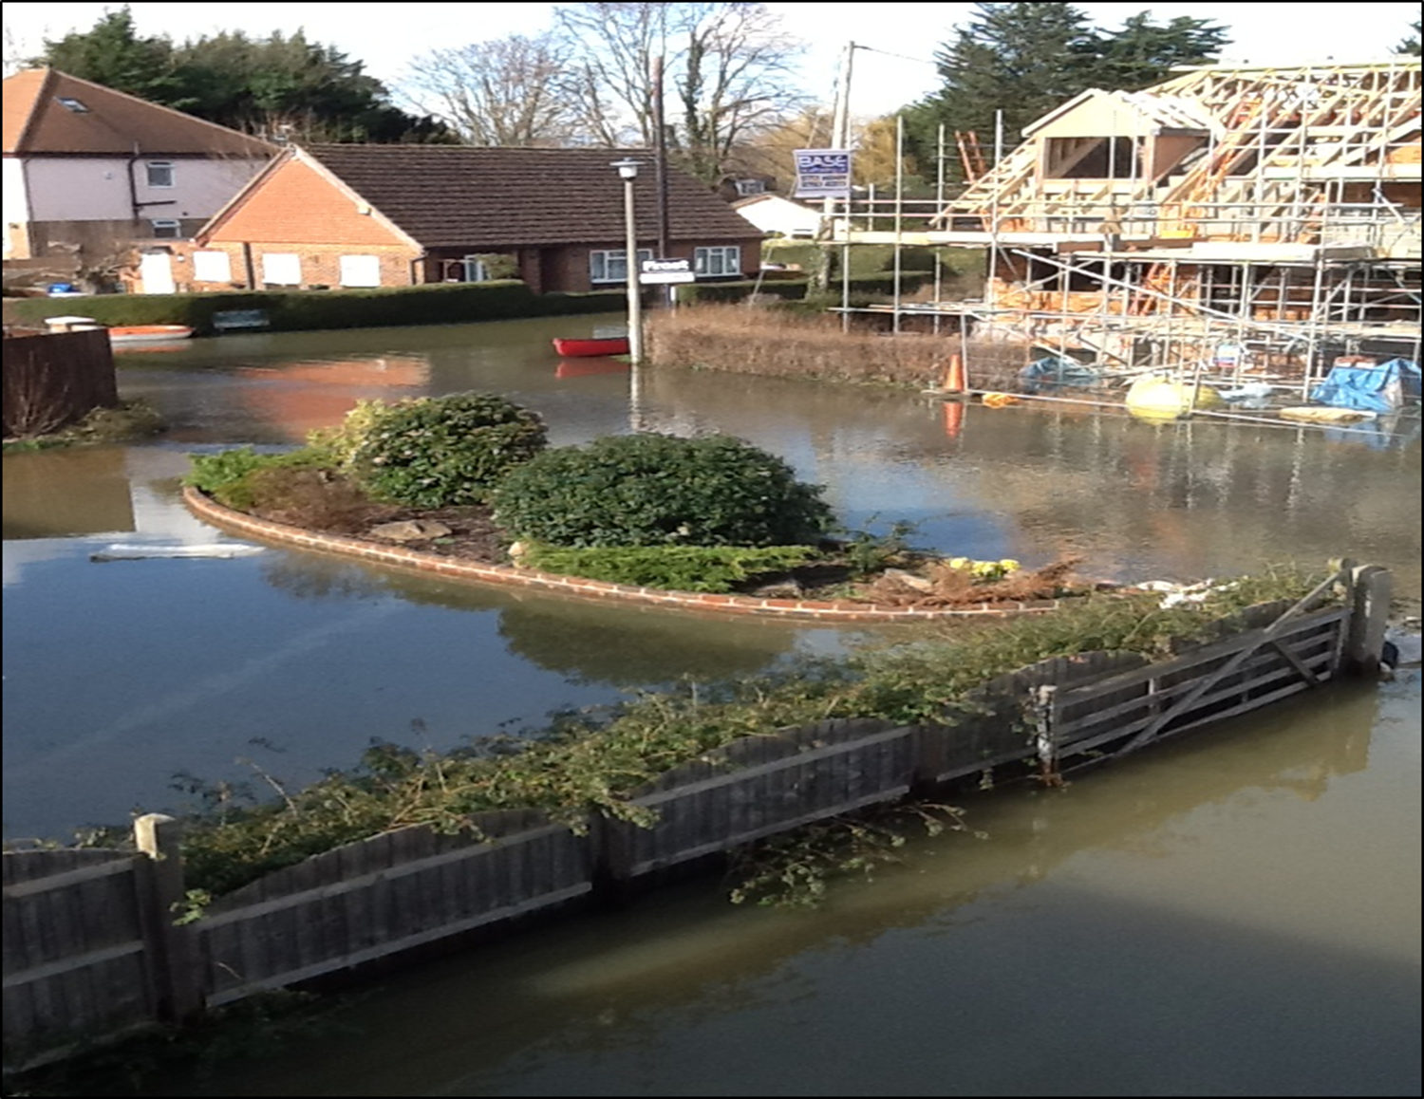

We didn’t think the water was gonna come in… We were just prepared that the roads would be closed.
Daniel, aged 14

Slide 8
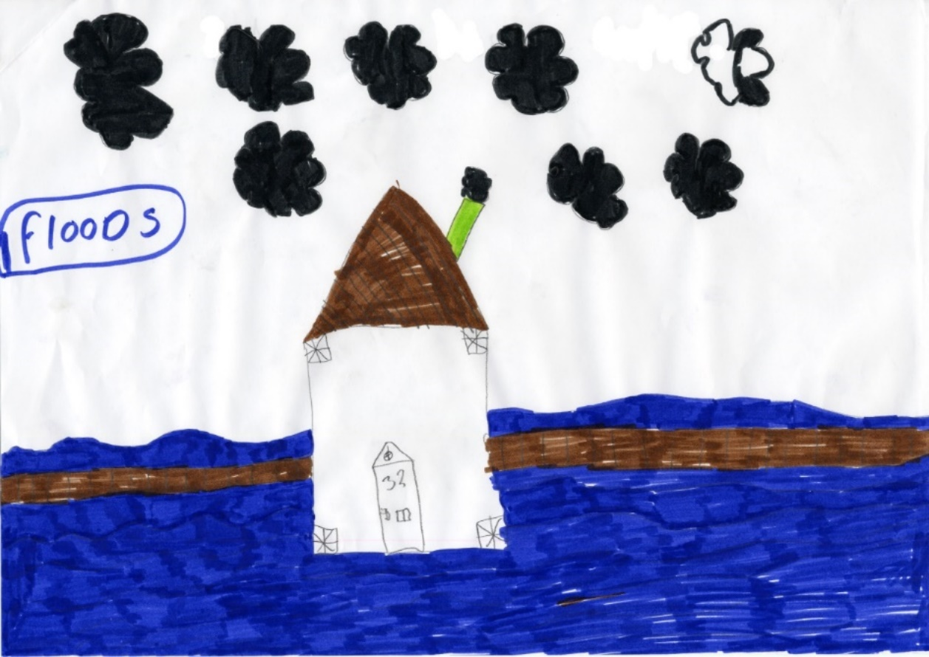
Mum and Dad just told us to get upstairs as soon as they knew it was coming, and so we just grabbed a few things and ran upstairs.
Louisa, aged 9

Slide 9

We was in the bath when it started… And I had to quickly get dried, slip some pyjamas on and Mummy had to bring the hairdryer with me. And I slipped my stompies on and we went out the door.
Amber, aged 6

Slide 10
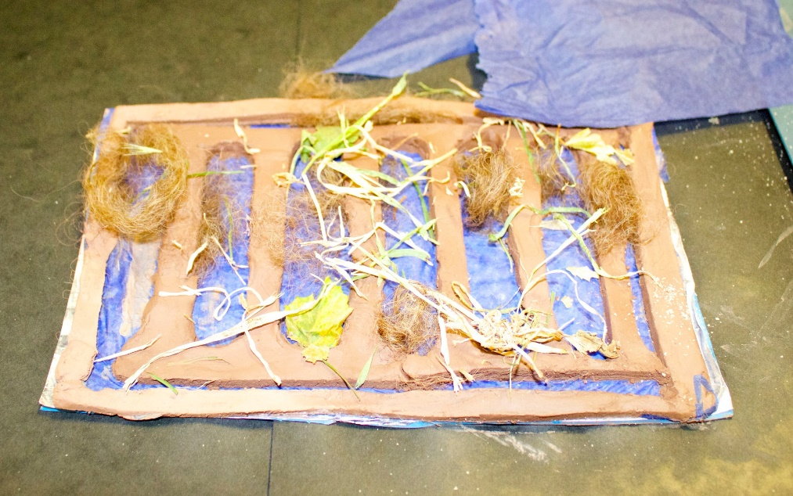
I was a bit scared… because down my road like the drains started coming off and then I thought like the drains here would like come off as well, so… I was a bit scared that like I’m going to fall down a drain.
Lewis, aged 14

Slide 11
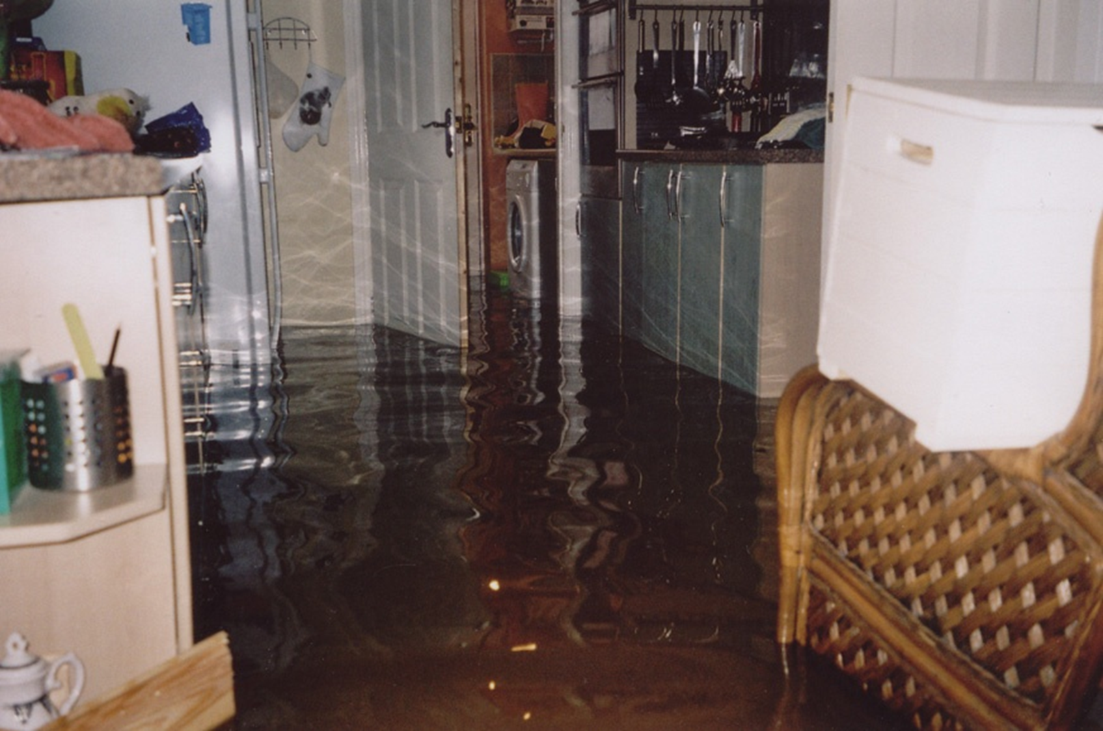
It’s not coming through the river it’s coming up the ground and that’s when we had to call my Dad in from work.
Ben, aged 12

Slide 12
The day after the flood…

Slide 13
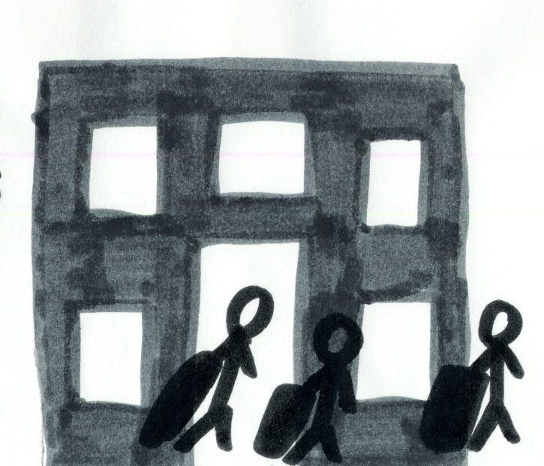
We stayed, but we had to like keep our clothes on during the night and our bags packed just in case we got evacuated…
Peter, aged 14

Slide 14
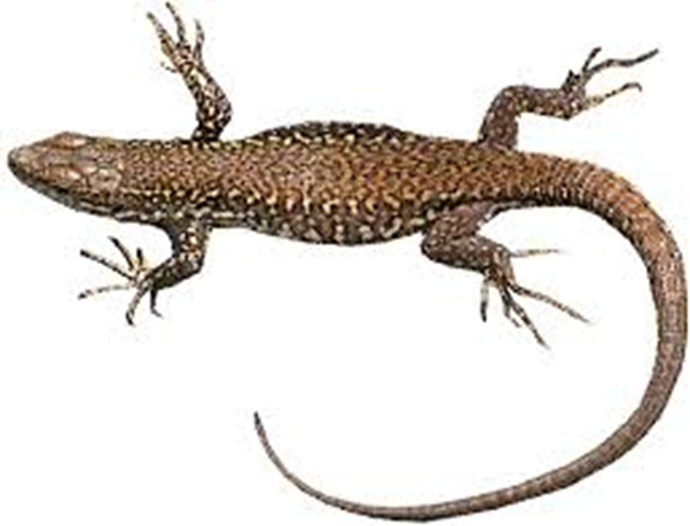
I basically just walked out because my Dad stopped a van… I went out with my brother and I got my lizard, made sure she was secure and everything, got into the van… because the power was going to go out very soon.
Andrew, aged 14

Slide 15
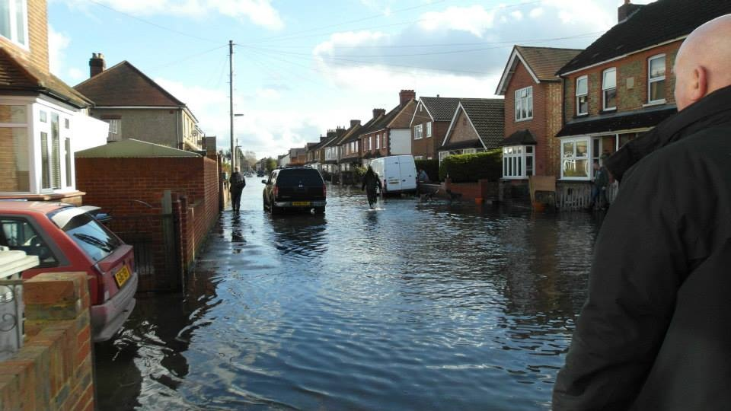
We have a lot of elderly down our road that can hardly walk. I wanted to go and help them…they had no-one…. I spent an hour in the morning…seeing if they wanted anything taking upstairs to their loft… Most of them had no family to help.
Daniel, aged 14

Slide 16
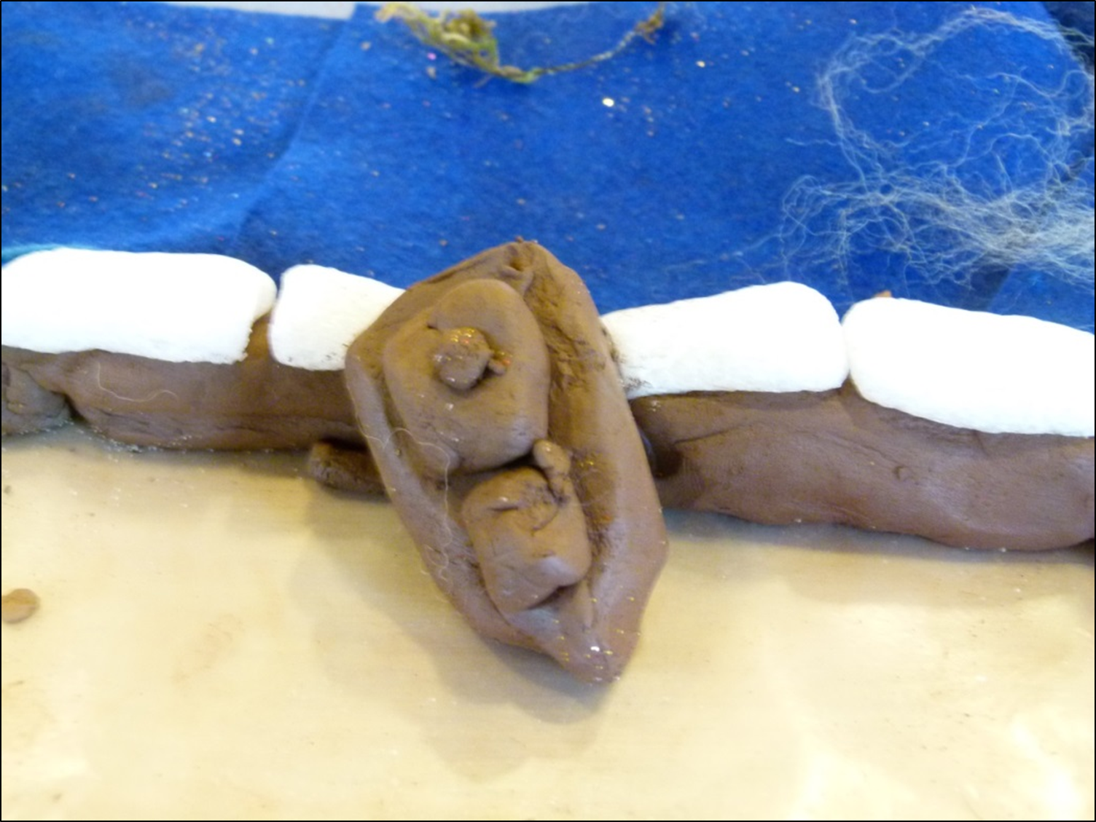
The next day when the water had gone down a bit, there was this boat and it was stranded.
Ben, aged 12

Slide 17
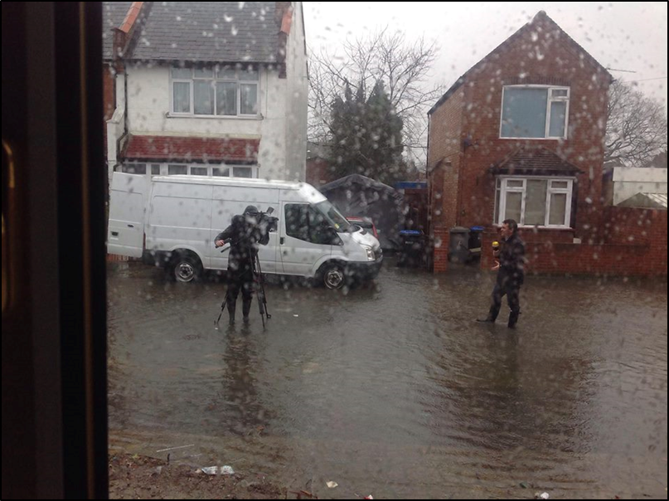
Streets and houses were underwater. It took days to subside. The disruption was ongoing…

Slide 18
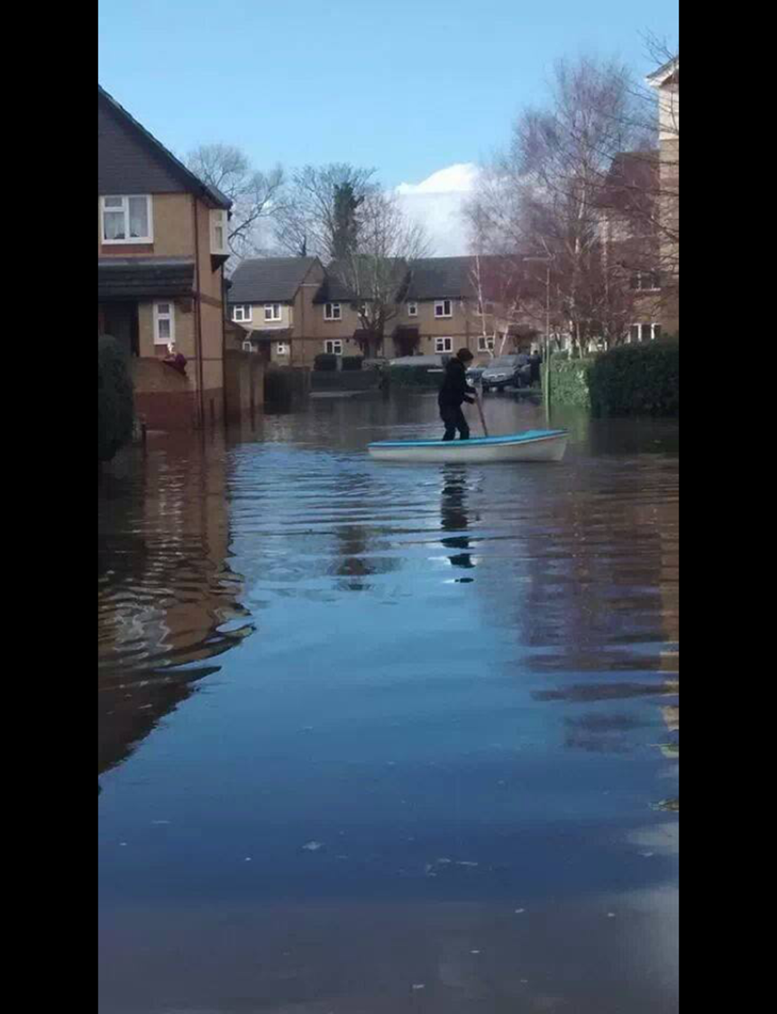
The Forgotten Street

Slide 19
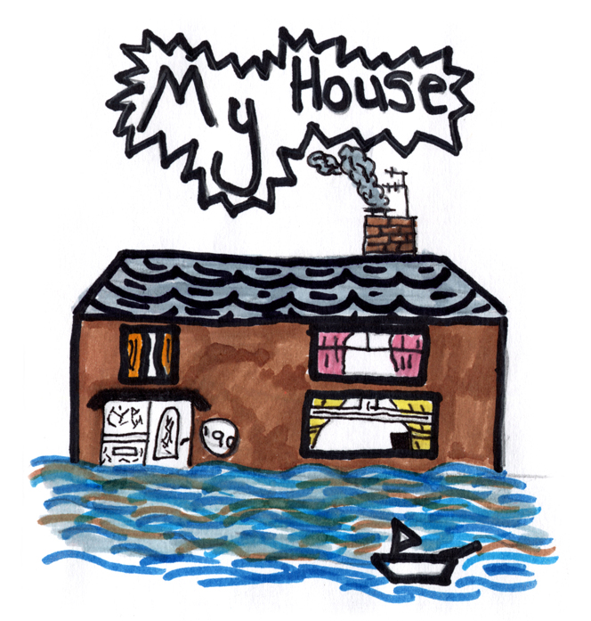

Slide 20
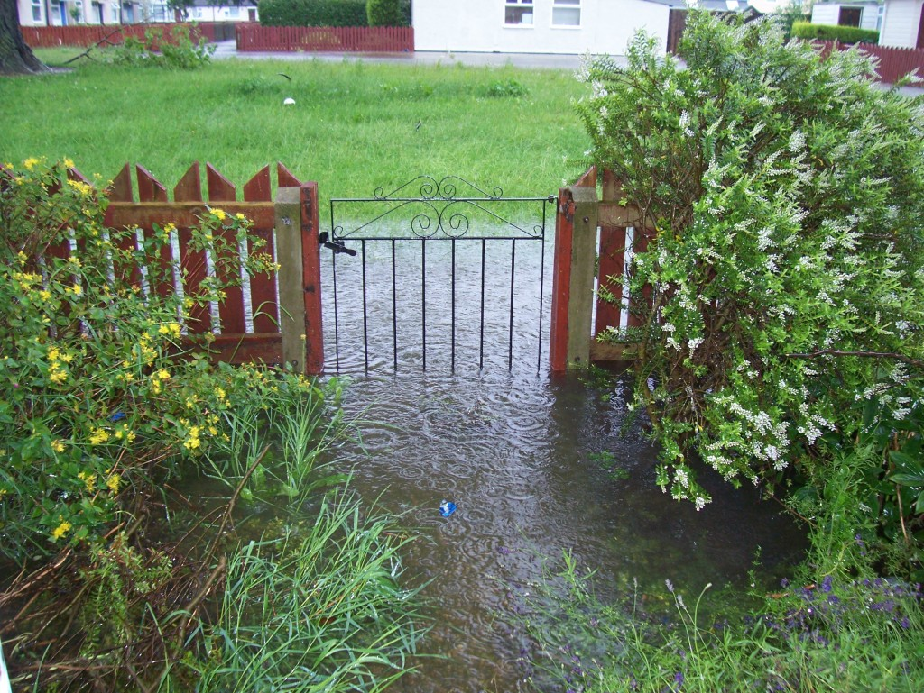
Dad opened the door to see what was happening and there was all this water sort of coming down … it went to the top step and Dad said, ‘We need to go now. When I say now, I mean now.’
Callum, aged 12

Slide 21
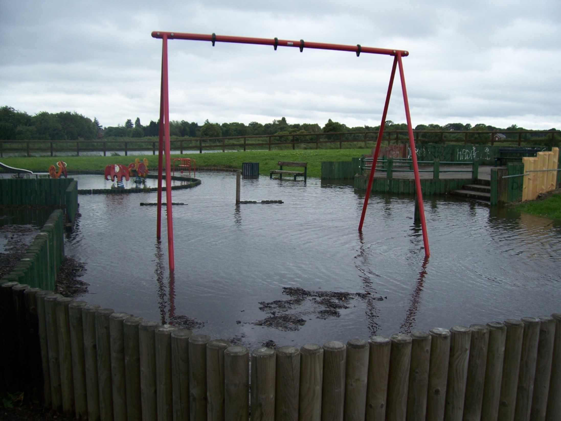
My playground

Slide 22
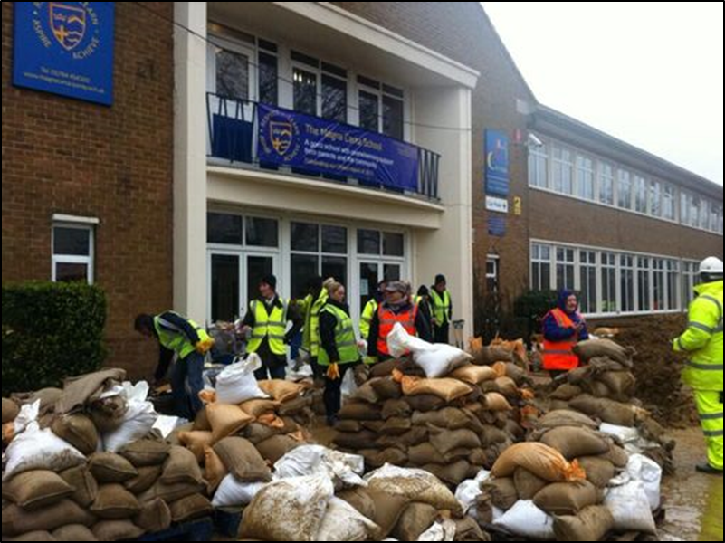
My school

Slide 23
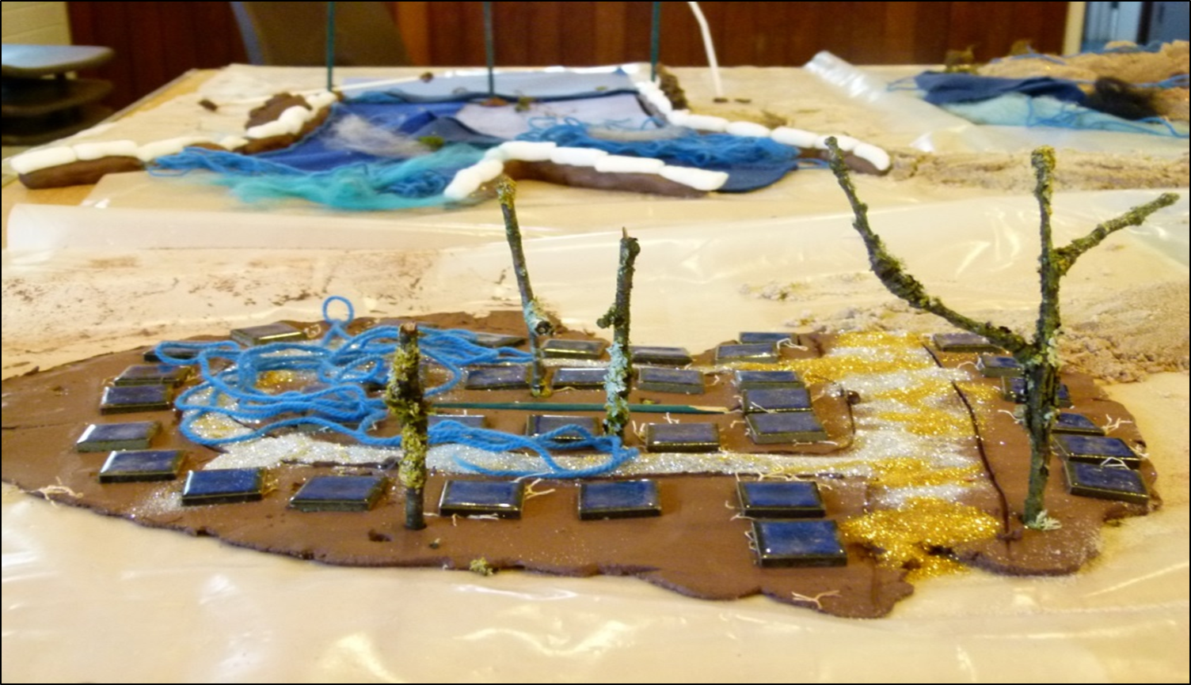
The floods were MESSY…. They had NO ORDER and it was CHAOS, because no one knew what to do.
Ben & Callum’s model of their flooded street

Slide 24
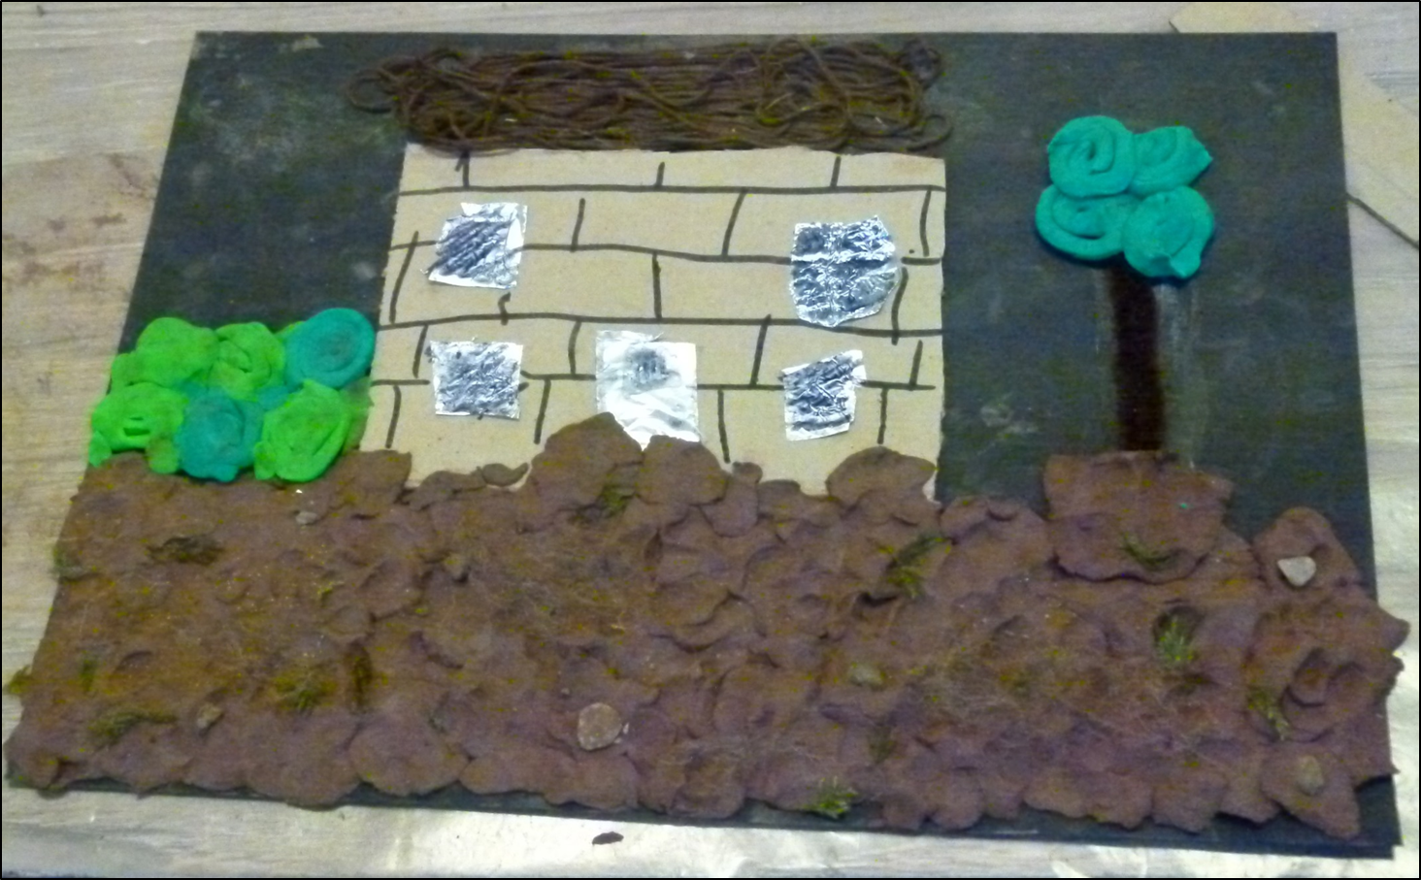
And there was mud after the flood…on the BUSHES, on the STEPS, and it was horrible.

Slide 25
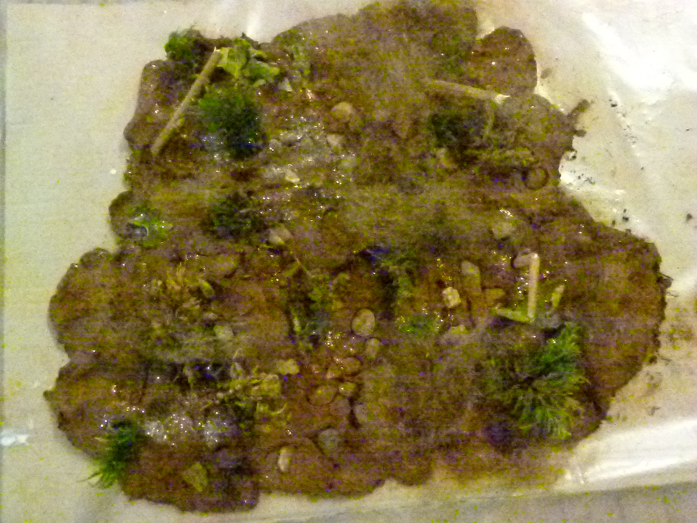
The water was really brown. It smelled. Air freshener… four bottles, haha - that’s what we needed…It lasted for weeks!
Thomas, aged 10

Slide 26
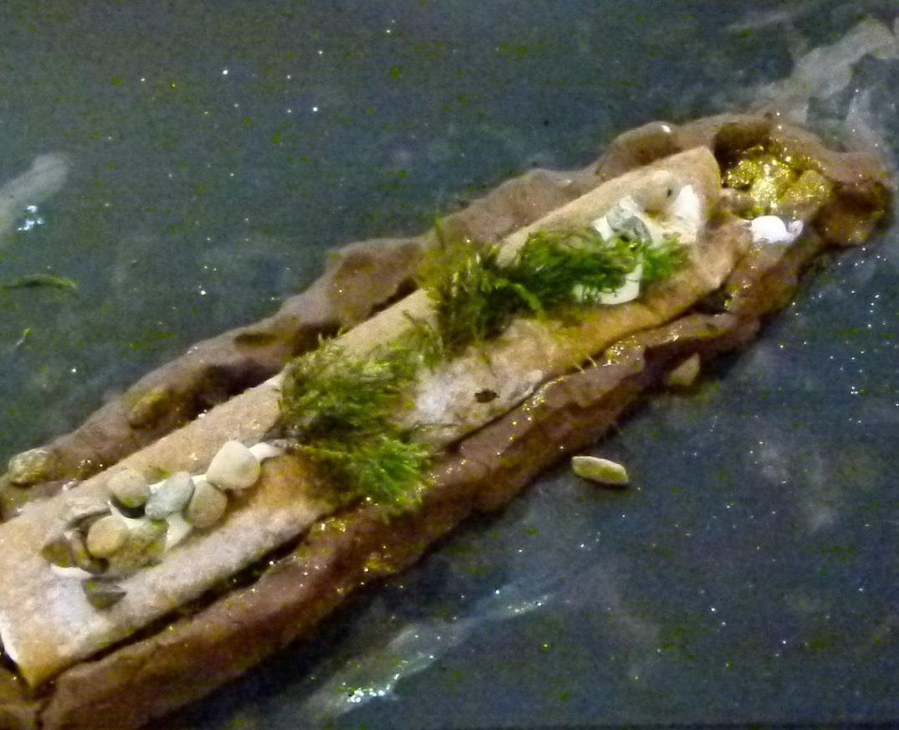
I saw gas bottles on the floor in different parts of houses. They were floated away by the water… And then we saw loads of bits of bricks and trees and stuff.
India, aged 9
Notes:
Reader 1 reads.
26

Slide 27
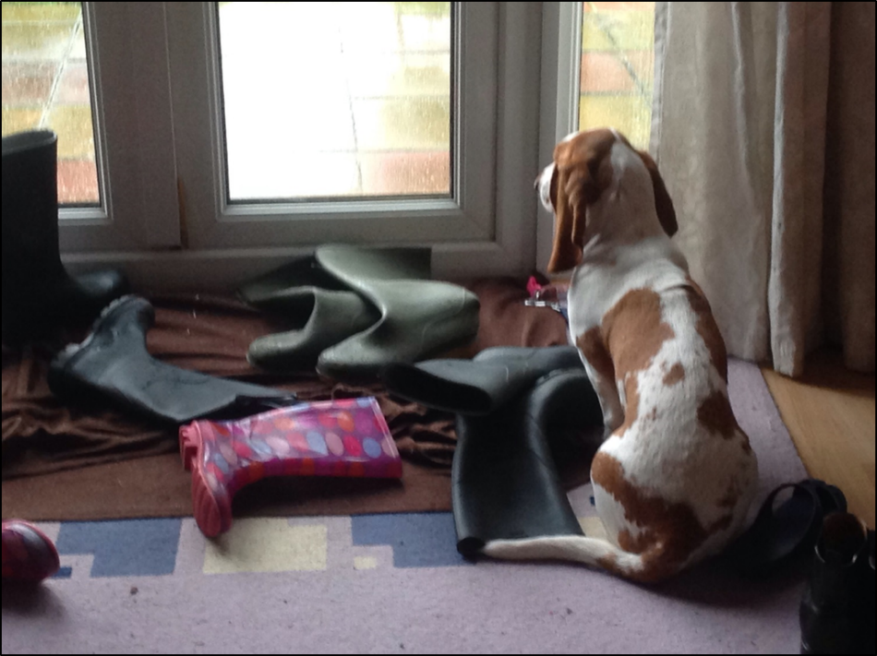
My dog wouldn’t stop crying because we couldn’t let him out… even a couple of days after, because of all the sewage - he might have ate it.
Peter, aged 14

Slide 28

My village school… was where all the people who were saved from their houses were. Me and my sister and her friend went down to see if they needed help…. We just served food and made tea and coffee for the people who were going out and rescuing people…
I felt quite good at myself then. I could have been home just watching TV and I was actually constructive and helping people.
Ruth, aged 14

Slide 29
Talking about recovery

Slide 30
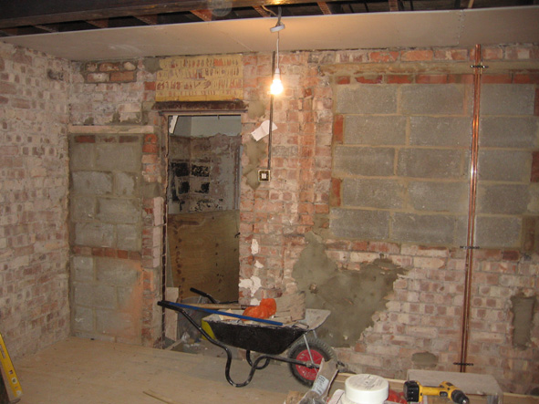
We saw the water in the house… it wasn’t a lot, it was just about three or four inches, but it can still do a lot of damage. You still have to knock the plaster off one metre up from that, so it creates a lot of damage, yeah, not good.
Andrew, aged 15

Slide 31
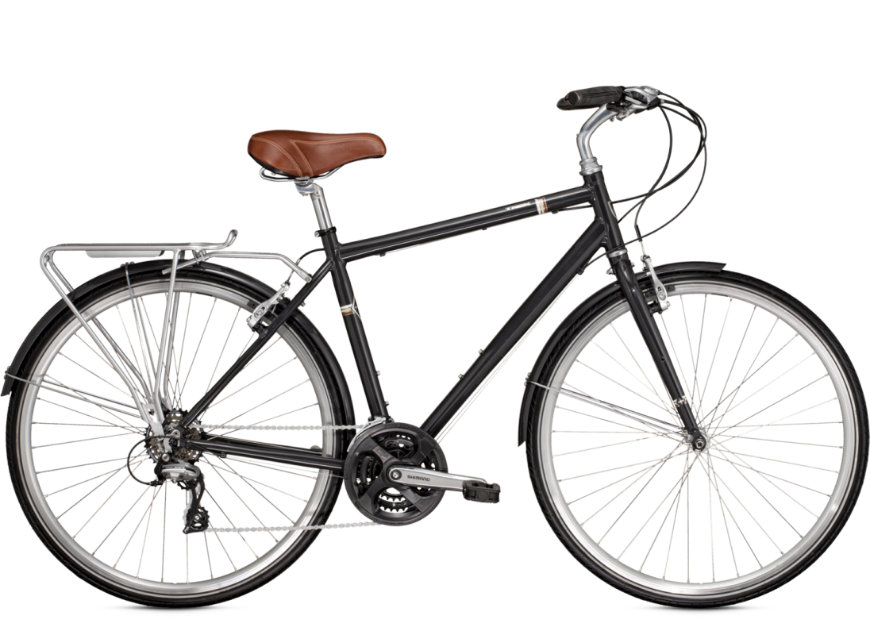
When we moved I couldn’t go to the park or anything with my friends because they were all so far away… They kept on asking me but I couldn’t get back, because my mum wouldn’t let me cycle in the dark.
Ben, aged 12

Slide 32
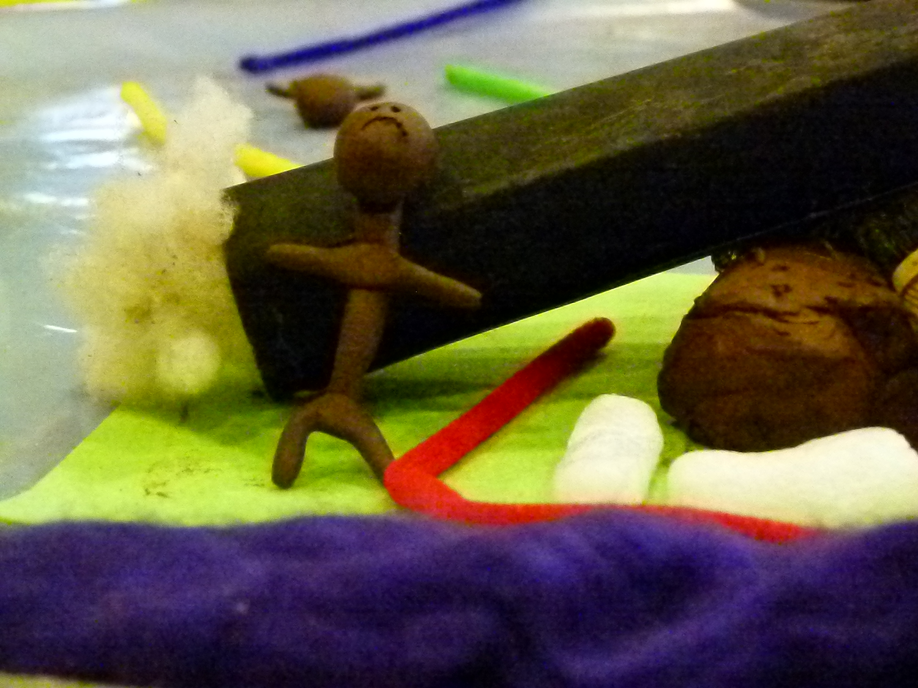
Callum moved in with his grandparents:
I could barely move in my room. I couldn’t get to sleep… I was so scared of it falling down on me… all my stuff, Mum’s stuff, everything from the kitchen, all the stuff from all the rooms.
Callum, aged 12

Slide 33
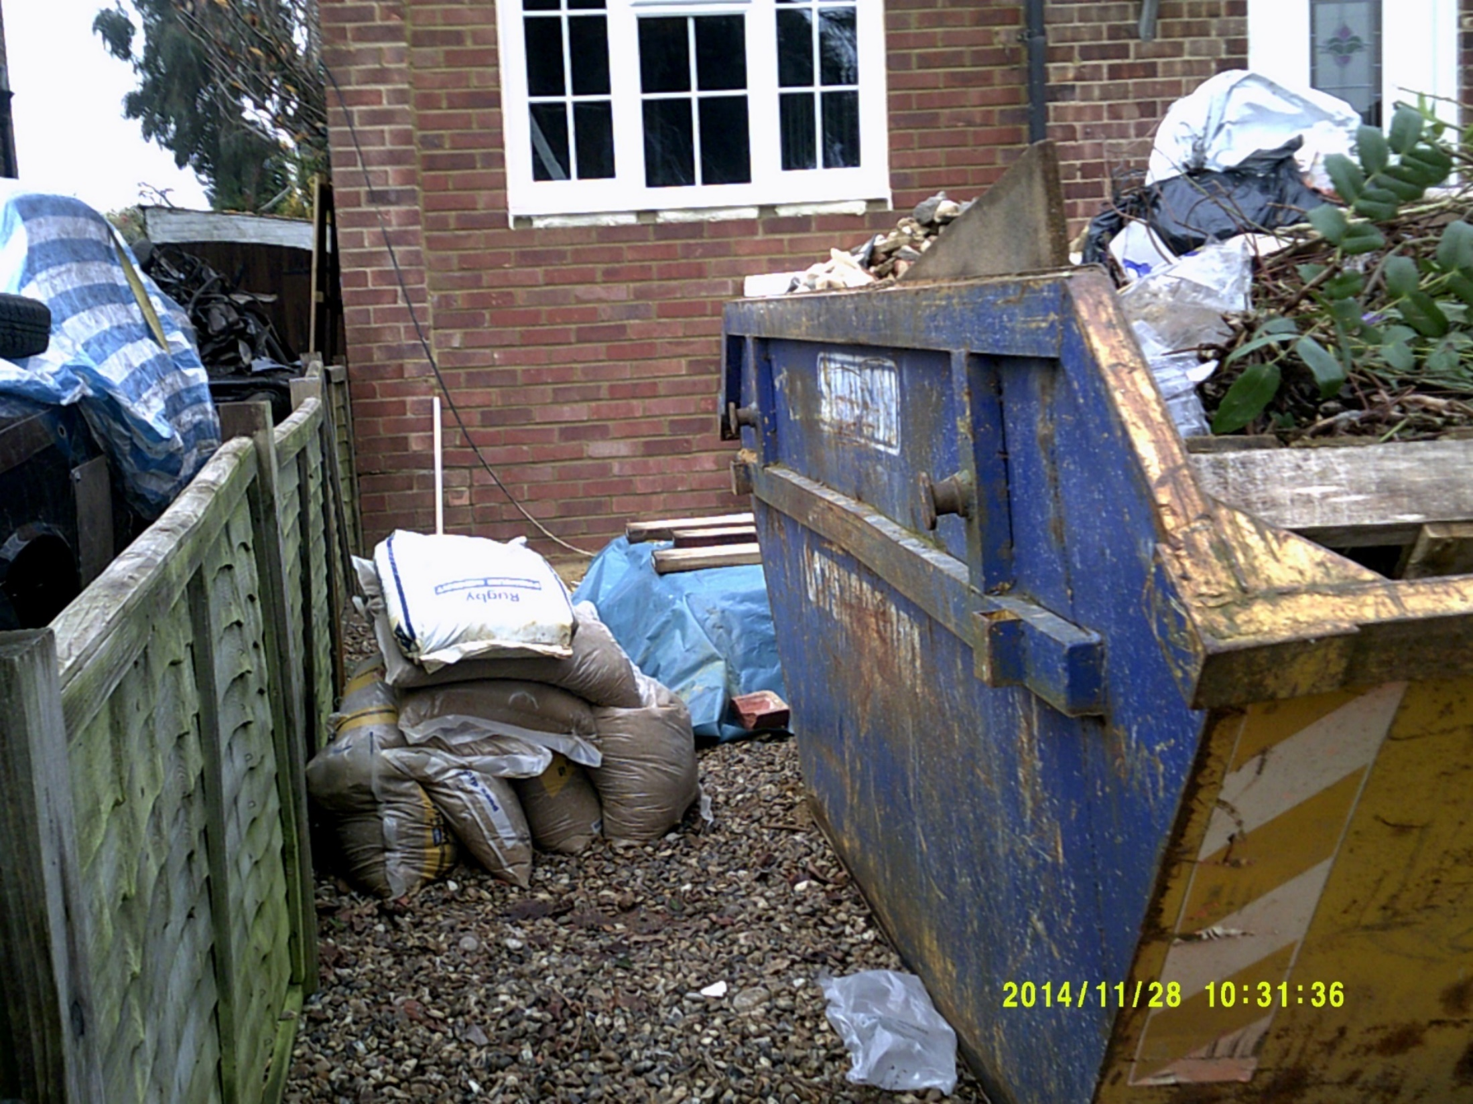
All the houses are empty. Like all you can see is like loads of builders and stuff. Well, you feel like it’s in a ghost town.
Callum, aged 12

Slide 34
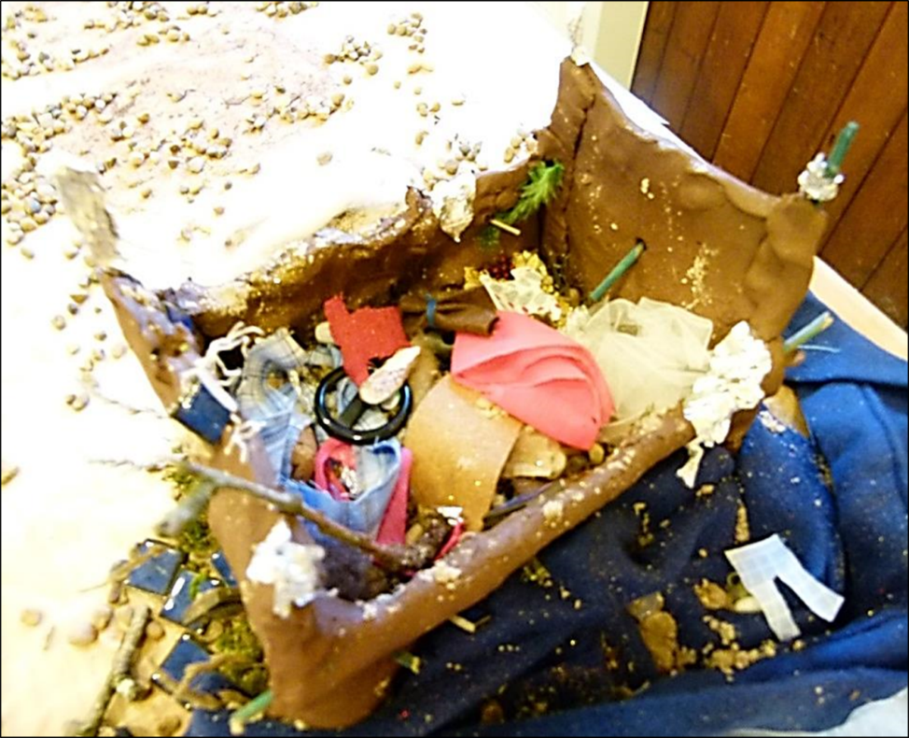
The stuff is covered in glitter because like they’re special things that you want to remember and you want to have forever but… obviously you can’t when they’re like ruined because of the floods.
Jodi, aged 14

Slide 35
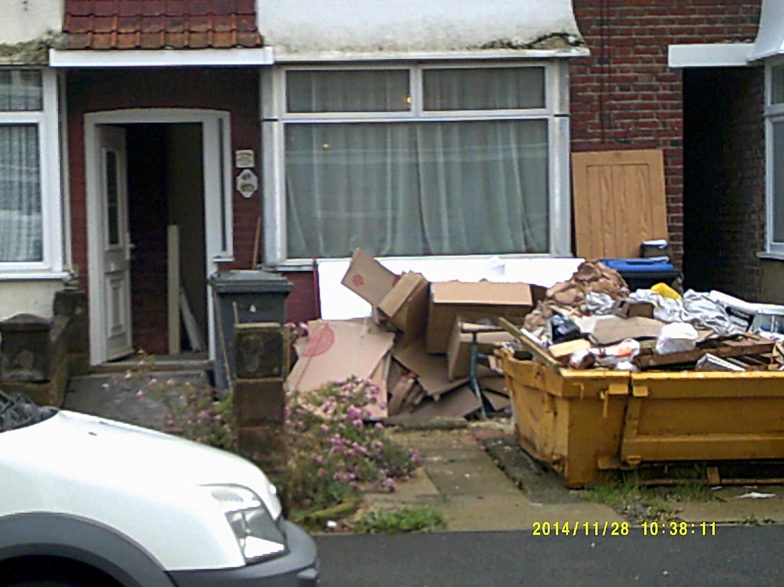
The skip shows the destruction the floods left…it shows all people’s memories and all their like precious things that got ruined.
Jodi, aged 14
Notes:
Please remove the timestamp if poss.

Slide 36
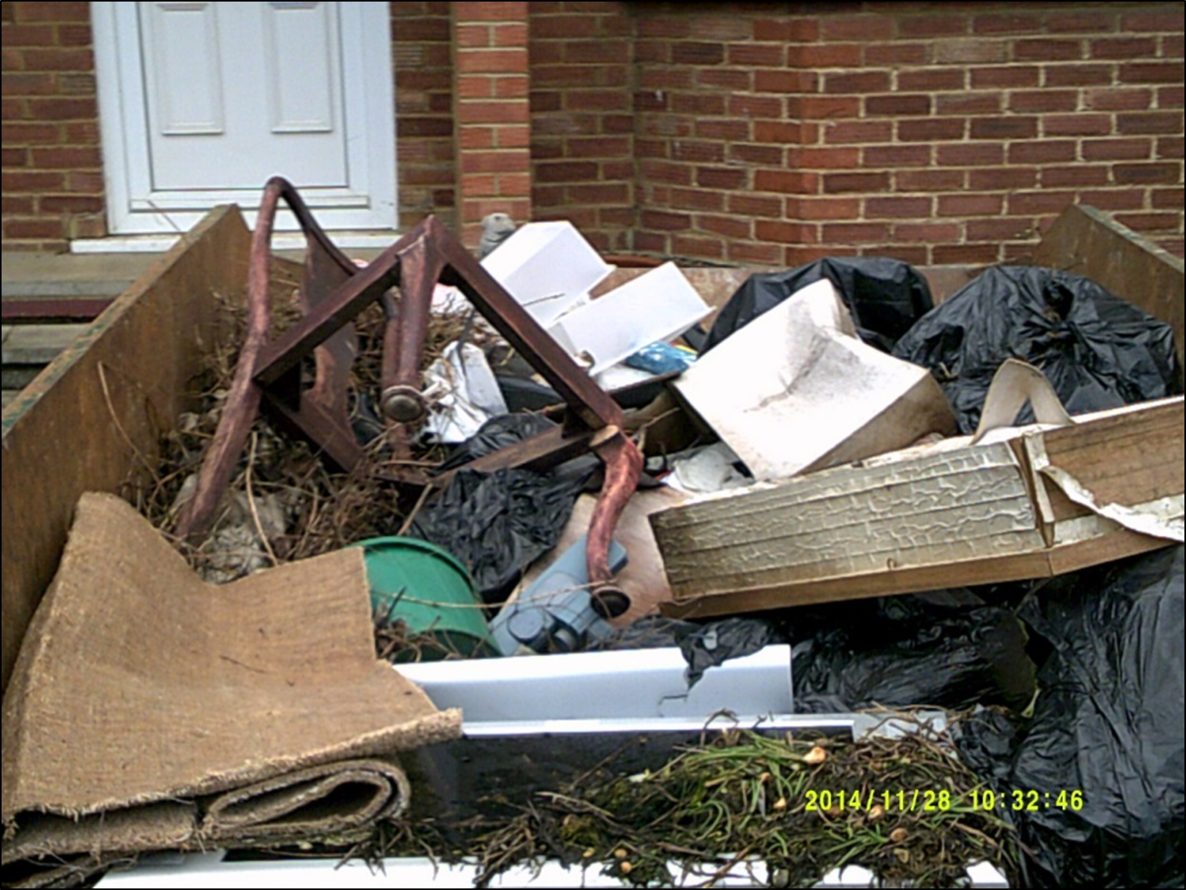
If your insurance were nice enough to give you a skip, then you were so grateful, you were so lucky.
Money couldn’t buy you a skip…
Jodi, aged 14

Slide 37
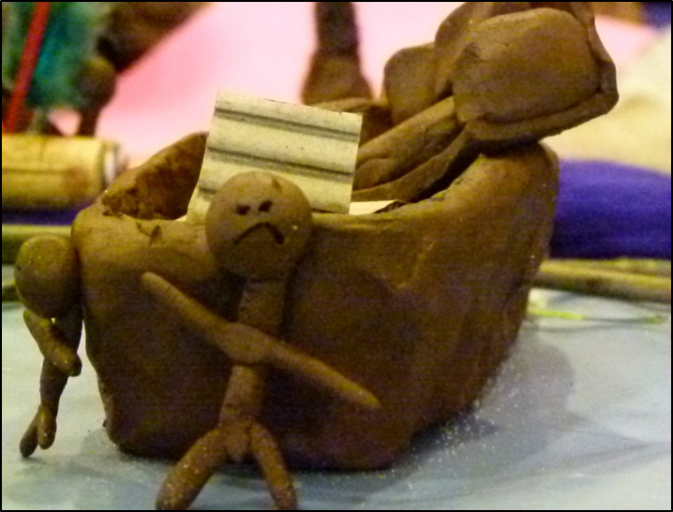
It takes a long time to get everything working again
Richard, aged 14

Slide 38

So we had to go online and get our work off of there. But I couldn’t because I’m in a hotel. The Wi-Fi was absolutely terrible, you couldn’t do anything, and this was when we were choosing options, GCSE options and I couldn’t even like fill out that form because it was online, I couldn’t print it out.
Andrew, aged 15

Slide 39

Living in a hotel, it wasn’t great… It was just weird because you don’t make your own cereal or anything; they just give it to you. It’s like, you want to do those everyday things!
Andrew, aged 15

Slide 40
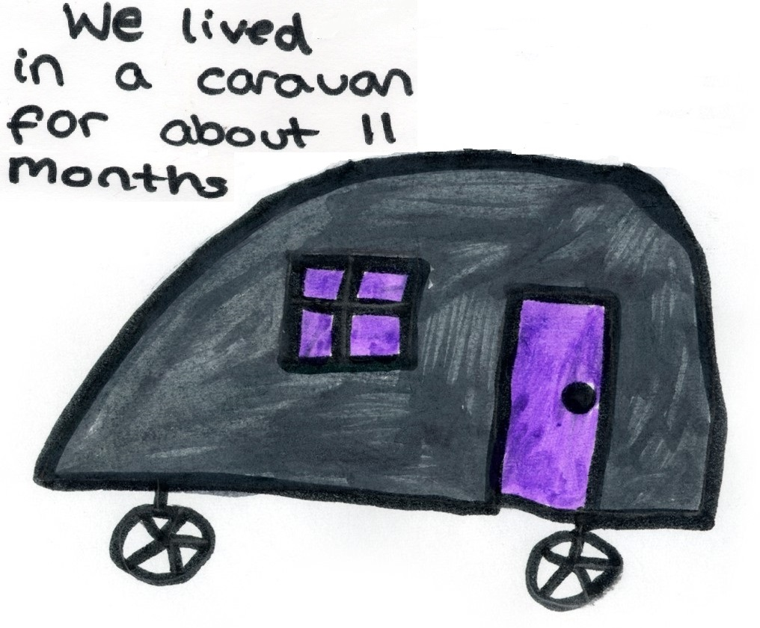

Slide 41
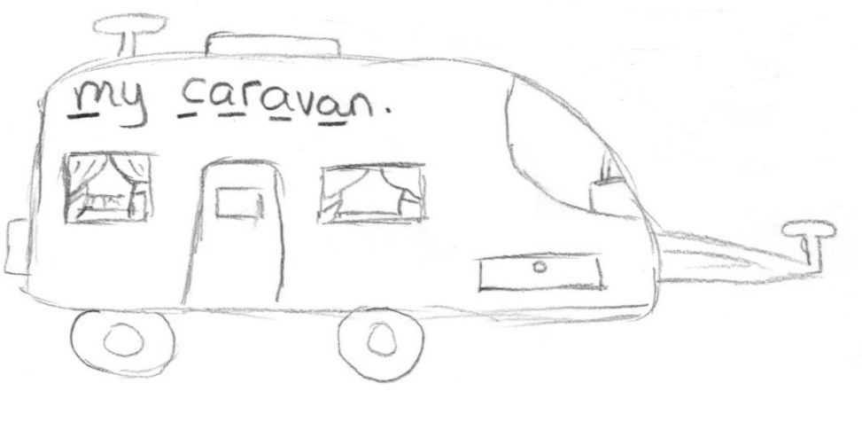
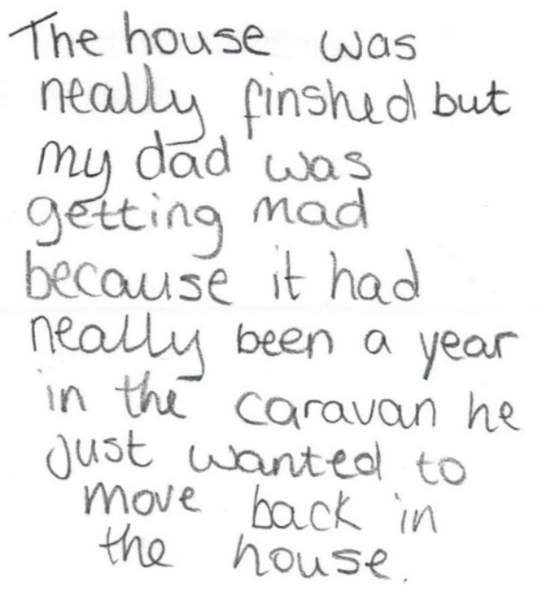

Slide 42
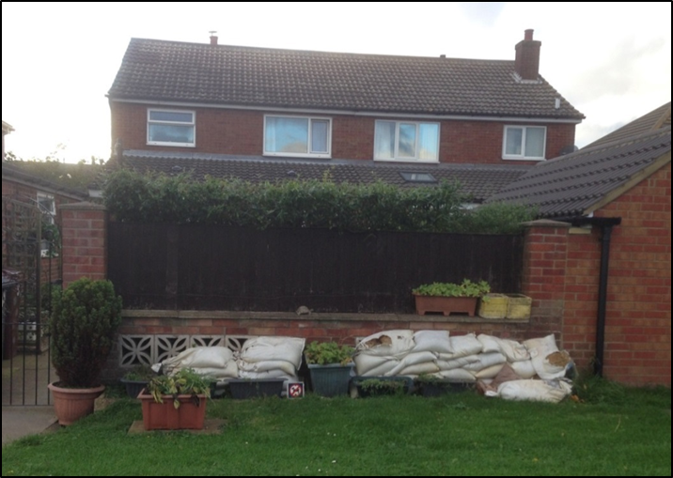
We got our drying certificate on Valentine’s Day…. You had to get one…. That means your house is completely dry and now you’re allowed to start working in it.
Louisa, aged 9

Slide 43
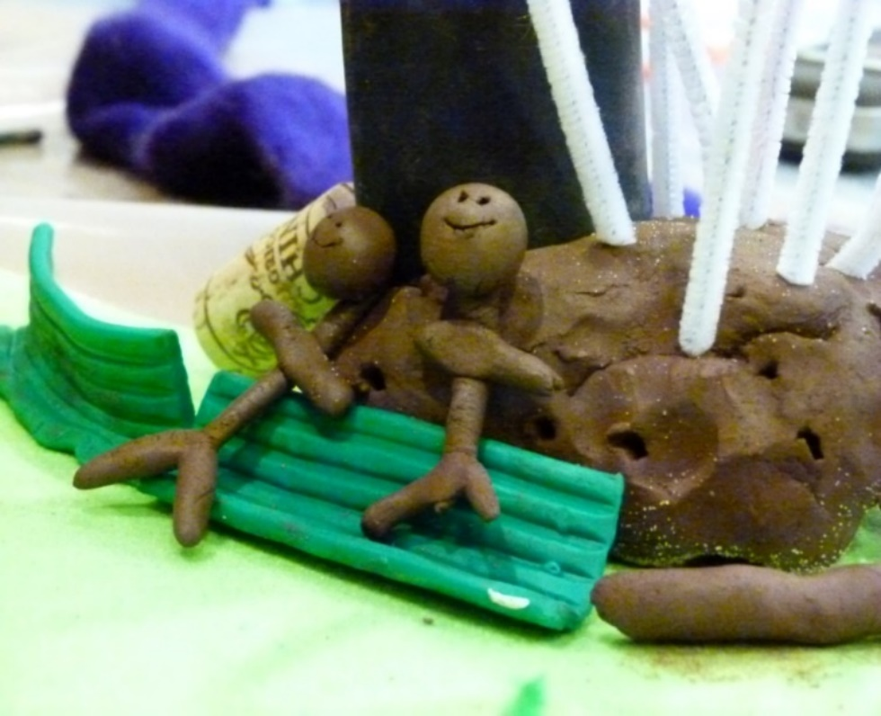
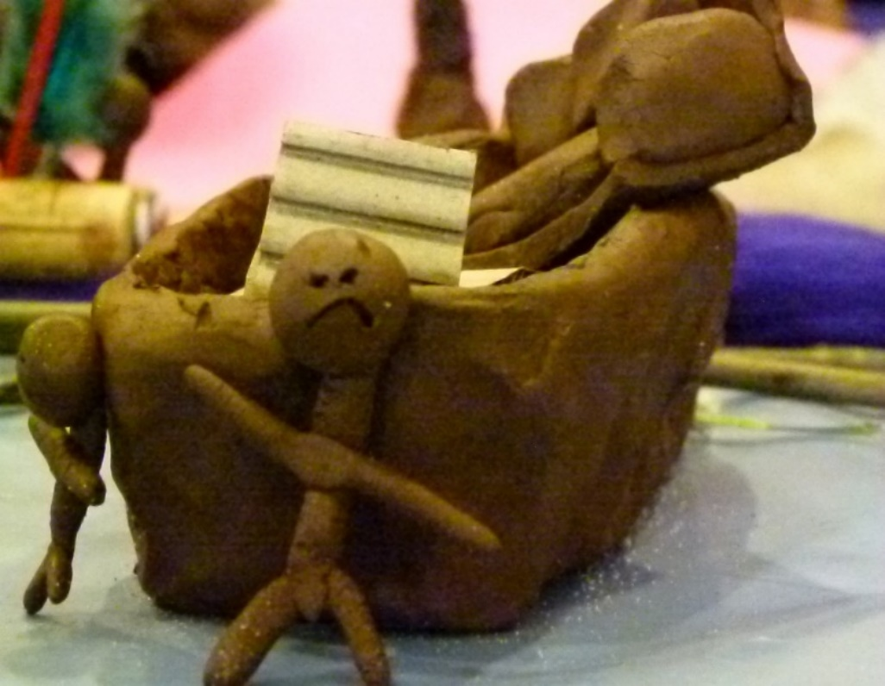
I made the people, so the happy ones are for before the flood, then it’s sad people for after as they have to repair everything and it takes a long time to get everything working and back to normal.
Richard, aged 14
Notes:
Reader 4 reads, then click IMMEDIATELY on to next slide
43

Slide 44
Talking about next time…

Slide 45
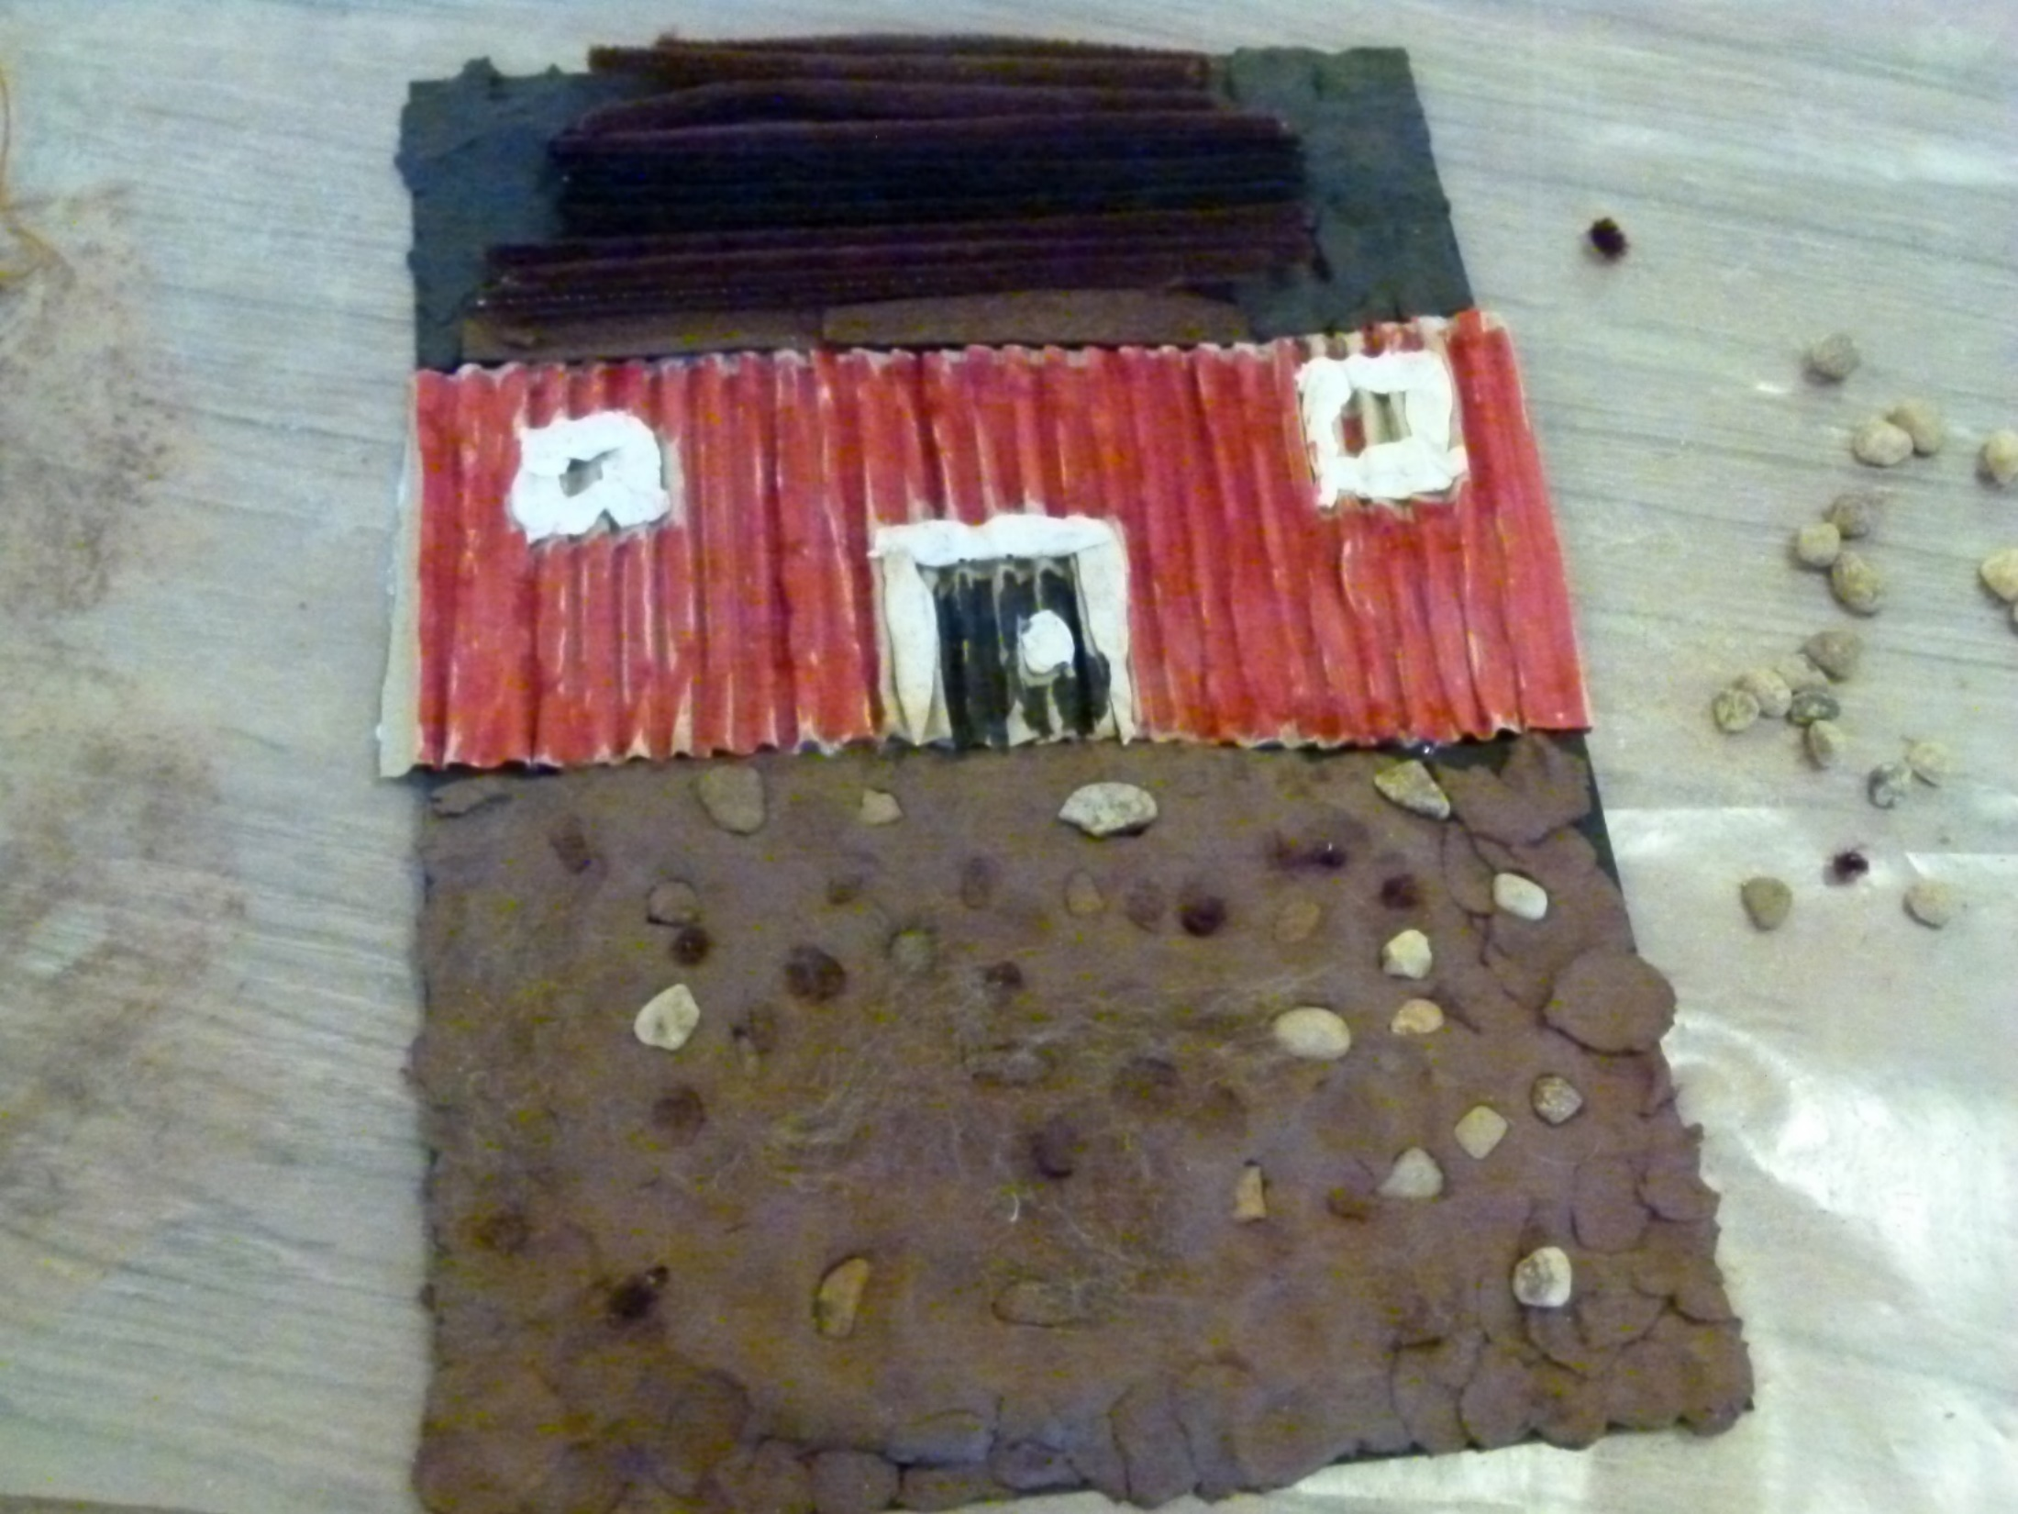
We’ve sorted out next time. We’ve got a flood toilet… The flood water can’t go inside it... And then we’re gonna turn all the lights off… and we’re gonna go upstairs.
India, aged 9

Slide 46
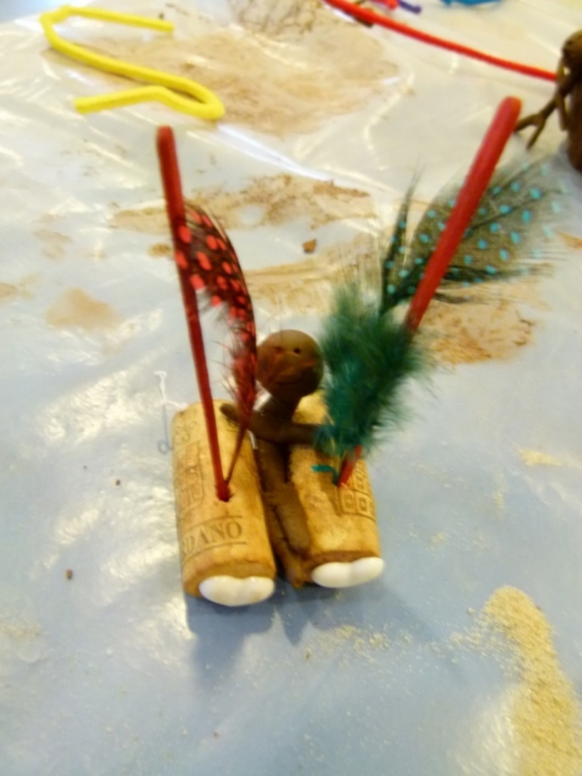
They didn’t realise that it would have ever flooded but now they realise that it will more than likely flood again, so they’ve bought themselves a little raft that I made…
… Because it’s happened before, it can happen again. They’re adapting.
Richard, aged 14

Slide 47
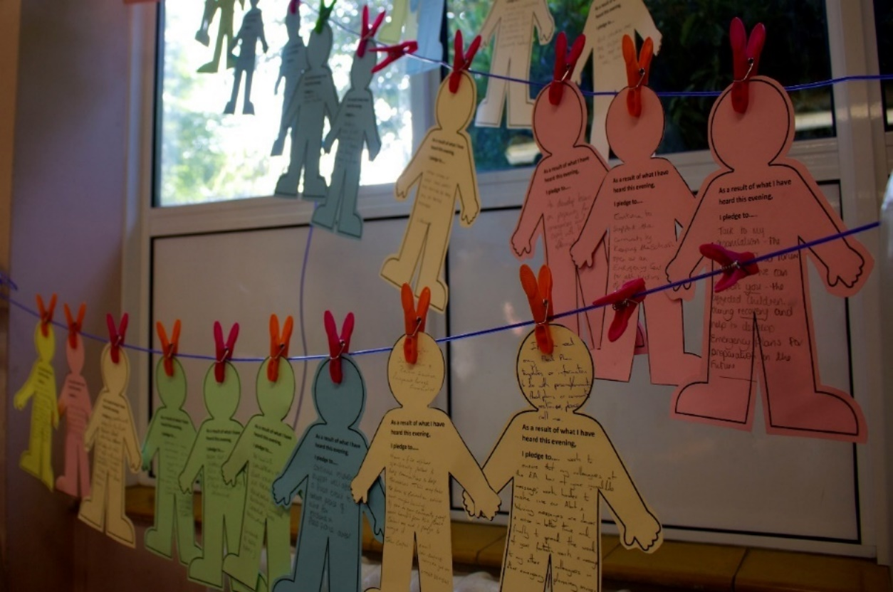
Adults need to know that children become more scared and worried when they do not know what is happening…children have the right to know.
Helena, aged 10

Slide 48
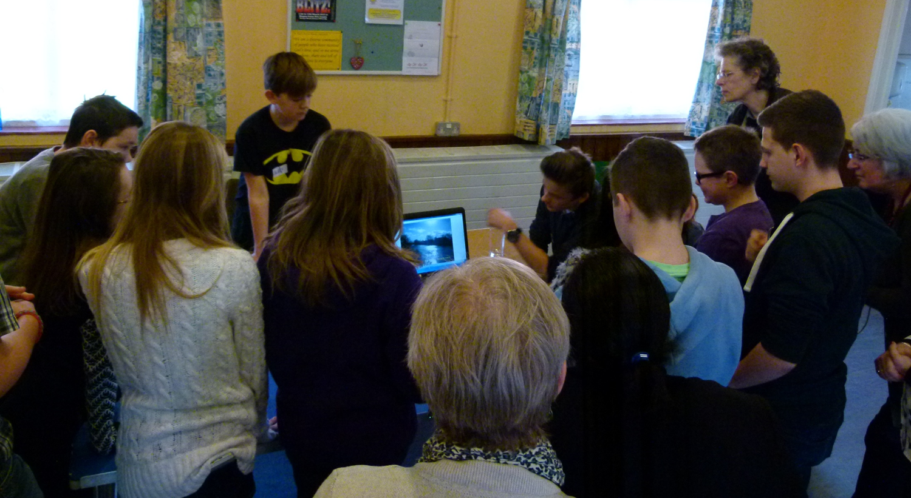
Everyone in here like understands what you went through, so you can talk to them and you know that they’re okay with listening, whereas outside they haven’t been through it.
Daniel, aged 14
Notes:
We have deliberately positioned the quote over the top of the front of the boy’s face (wearing the batman t shirt) for anonymisation.

Slide 49
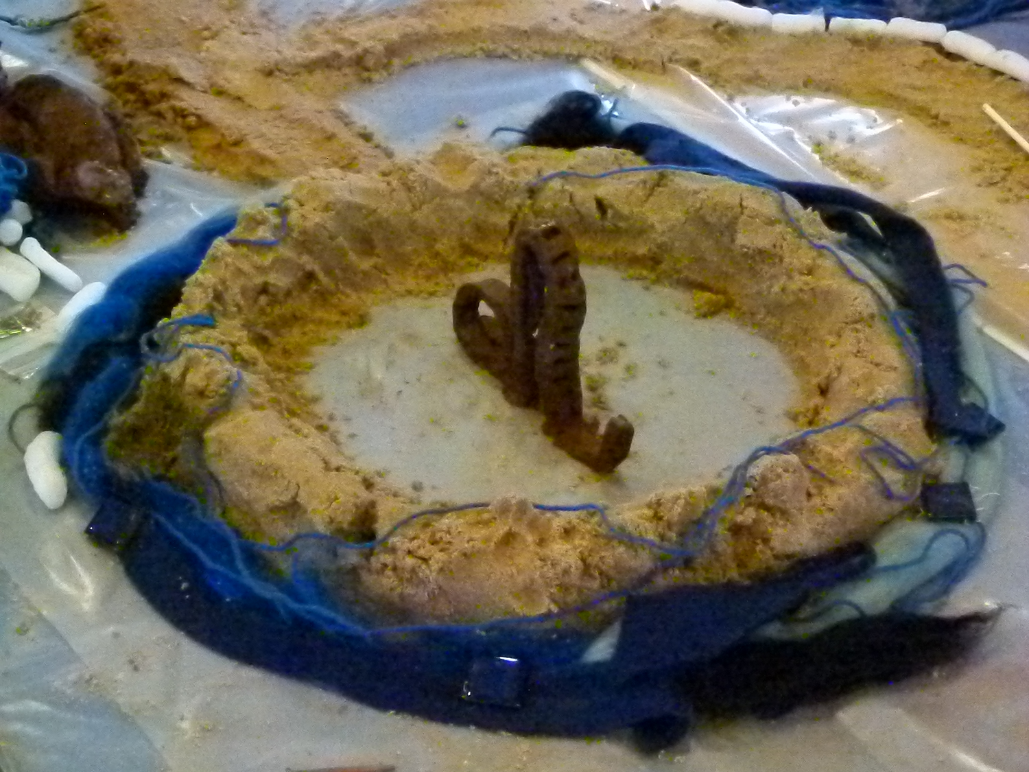
I’m just kind of like worried it’s going to happen again this year… I suppose I’m going to worry every year though. Even if it doesn’t happen, we’re still going to worry.
Jodi, aged 14

Slide 50
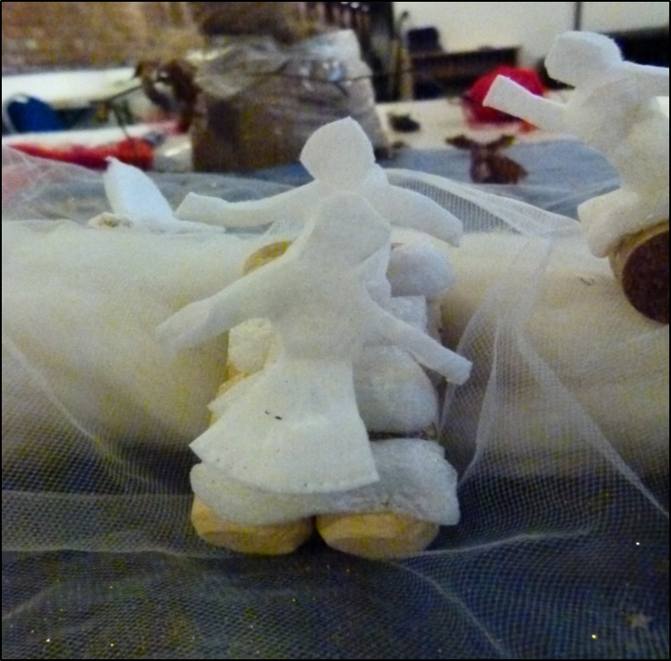
I think they should improve…The firemen could say: ‘Come on… we should go. I don’t know if it’s gonna be true, but we should go just in case, because we don’t want you getting hurt.’
Britney, aged 8

Slide 51
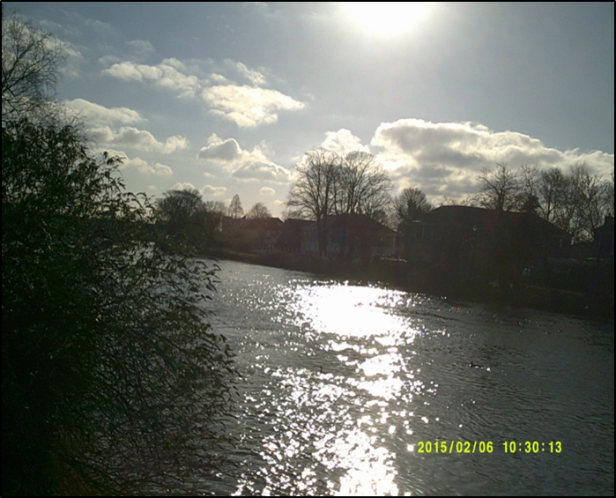
The level’s gone back down and it’s like quite nice to go there… and they’re all recovering and starting to move back in…
BUT… it could go back again, and when you’re there people do kind of forget about what it was like a year ago… They forget it could happen again…
Daniel, aged 14
Notes:
Please can you photoshop the datestamp out especially because the date is incorrect!

Slide 52
Looking to the future

Slide 53
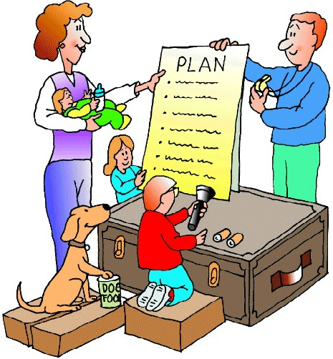

In Future:
Families and communities must prepare and make a flood plan.

Slide 54

In Future:
Flood warnings must be clearer so people understand them.

Slide 55
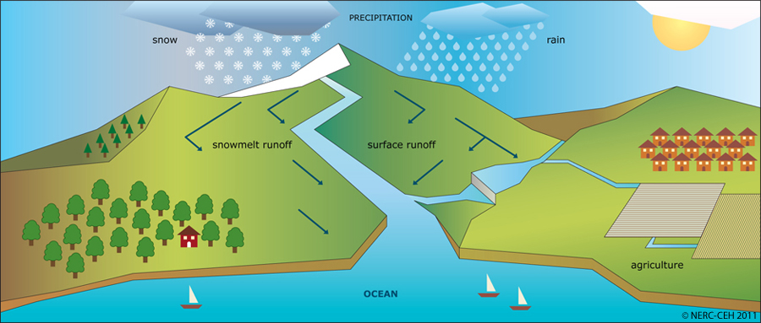
In Future:
We want lessons in school about flooding and other emergencies.

Slide 56
In Future:
Teachers should have training about floods and how they affect people.

Slide 57
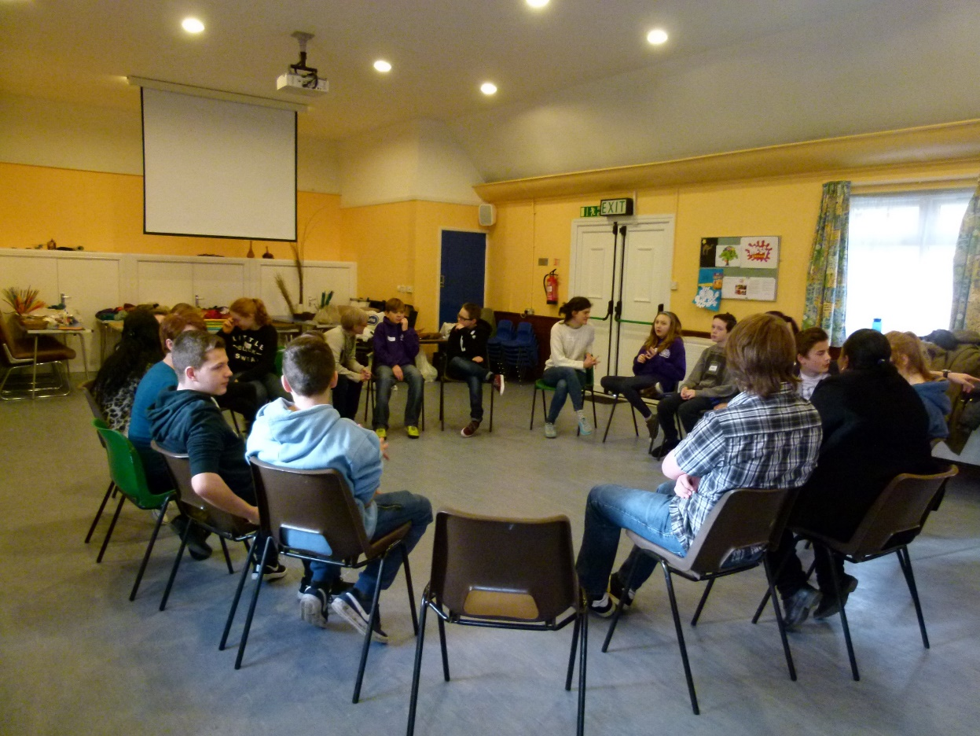
In Future:
Groups should be set up for children who’ve been affected so they can talk and get support.

Slide 58
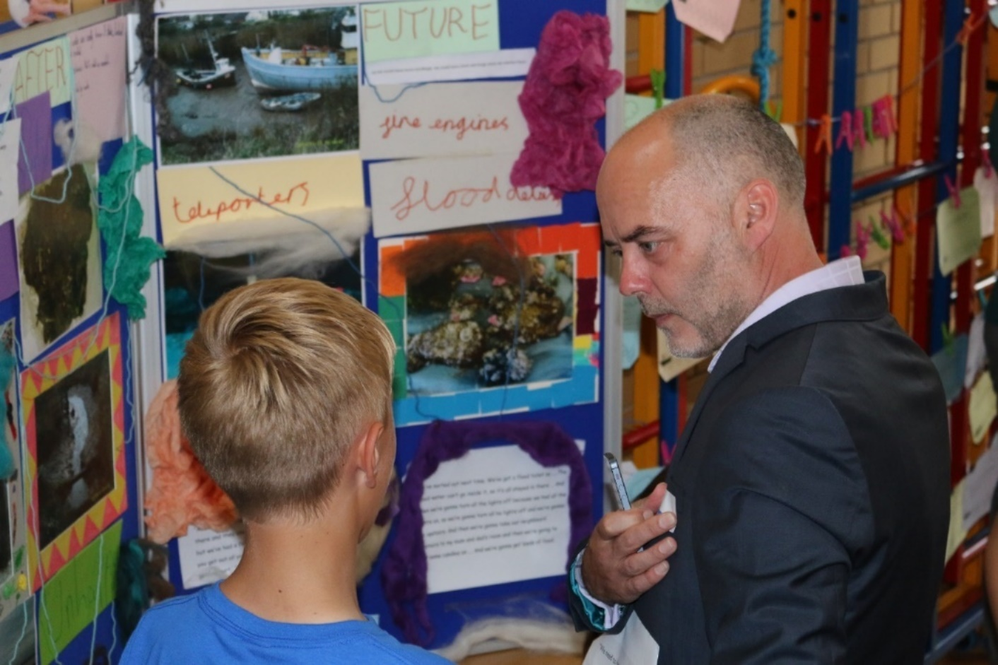
In Future:
Insurance companies must listen to what children and families need.

Slide 59
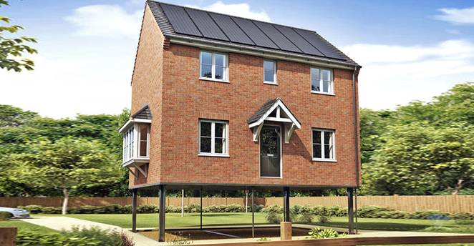
In Future:
We want better flood defences – when building on flood plains build on stilts!

Slide 60

Support children to prepare and recover from:

